Slide 1
Stochastic Programming
MIE 1620
Nov. 6, 2019
FARMING EXAMPLE
Instructor: Roy H. Kwon

Slide 2
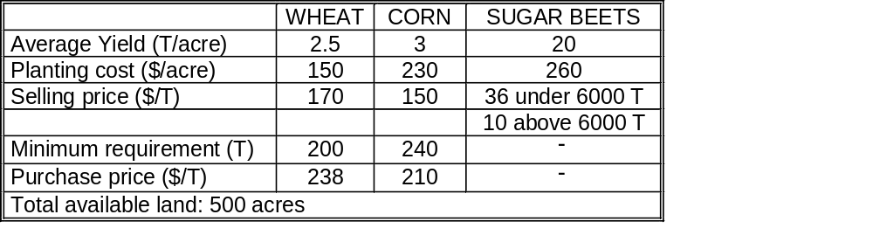
Initial Data

Slide 3
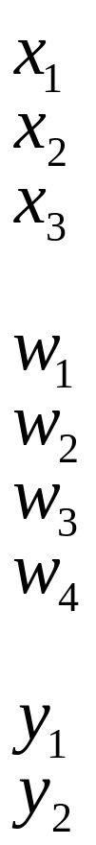
Variables
- acres of land devoted to wheat
- acres of land devoted to corn
- acres of land devoted to sugar beets
- tons of wheat sold
- tons of corn sold
- tons of sugar beets sold at favorable price
- tons of sugar beets sold at lower price
- tons of wheat purchased
- tons of corn purchased

Slide 4
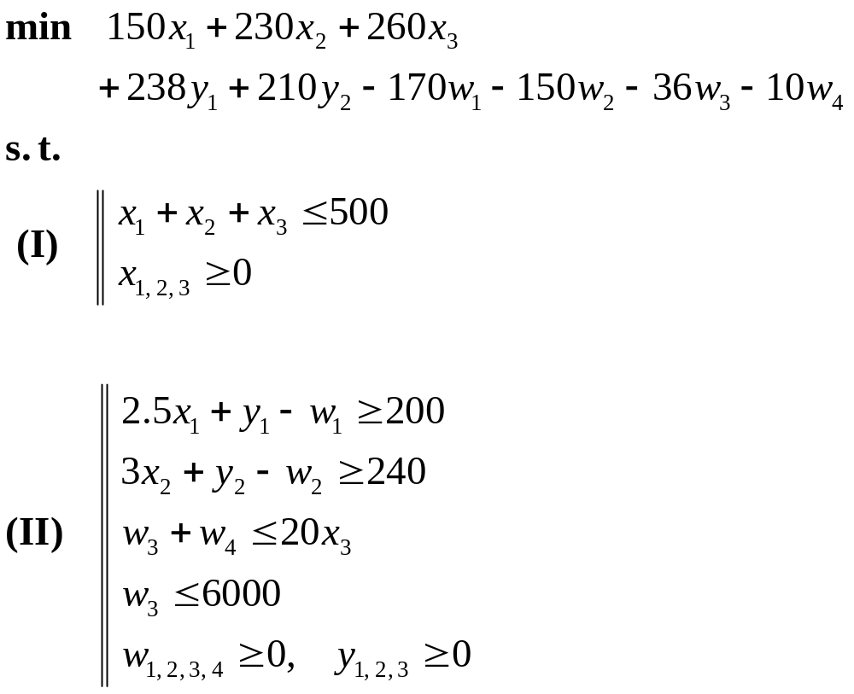
Deterministic Setup of Optimization Problem

Slide 5
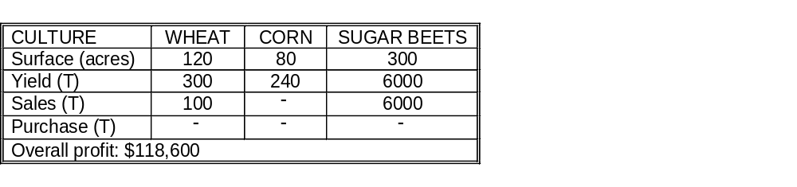
Optimal Solution for Deterministic Optimization problem

Slide 6
Scenario Analysis
Optimal solution based on expected yields
Scenario 2

Slide 7
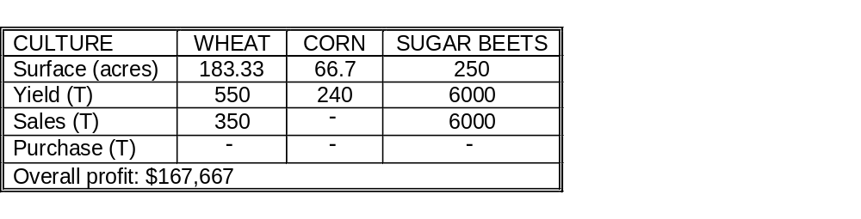
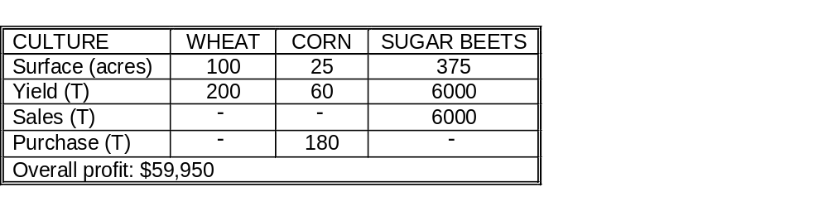
Scenario Analysis (cont’d)
Optimal solution based on above average yields (+20%)
Scenario 1
Optimal solution based on below average yields (-20%)
Scenario 3

Slide 8
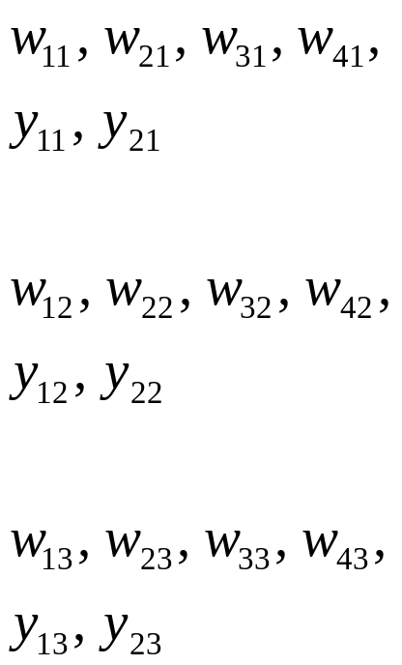
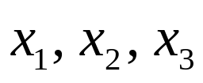
Extensive Form of Stochastic Problem
Scenario approach:
Yield
(W, C, SB)
1st scenario
the second stage -
+20%
(3.0, 3.6, 24)
probability
1/3
2nd scenario
1/3
0%
(2.5, 3.0, 20)
1/3
3d scenario
-20%
(2.0, 2.4, 16)
Decision
- the first stage

Slide 9
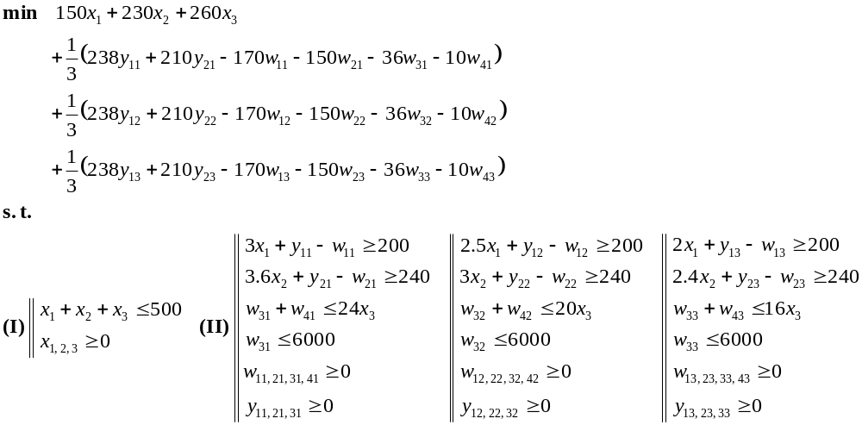
Extensive Form of Stochastic Problem
(cont’d)
1st scenario
2nd scenario
3d scenario
1st scenario
2nd scenario
3d scenario

Slide 10
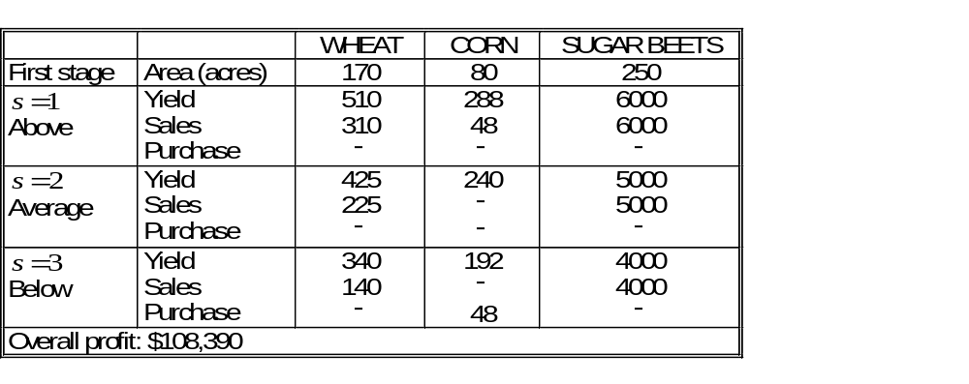
Extensive Form of Stochastic Problem
(cont’d)
Optimal Solution:

Slide 11
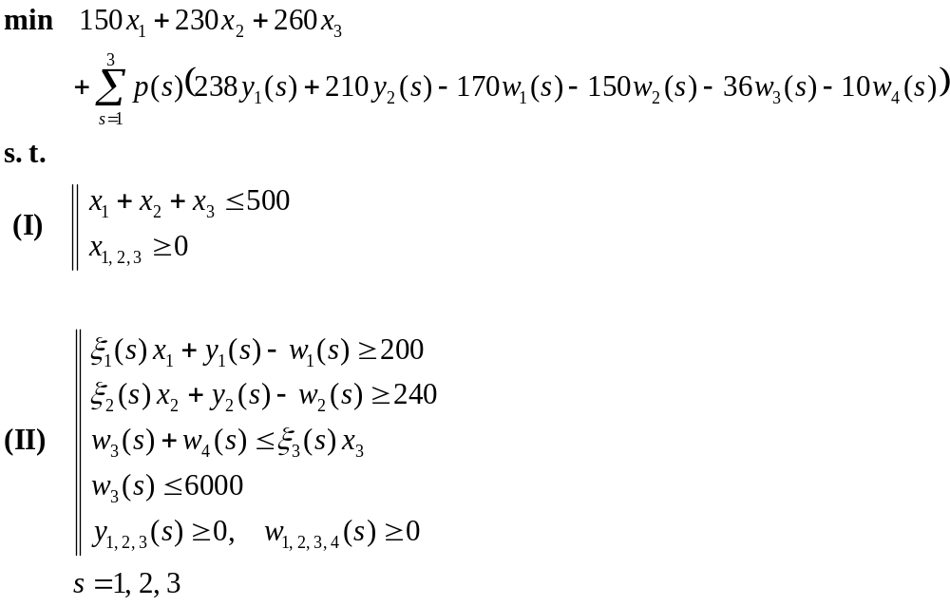

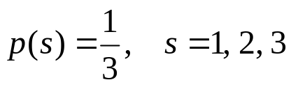
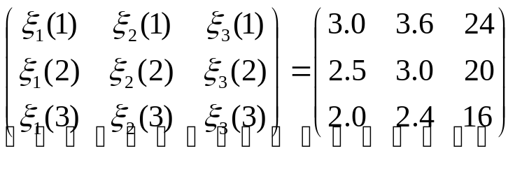
Recourse Reformulation of Stochastic Program
- s-th scenario
Random matrix

Slide 12
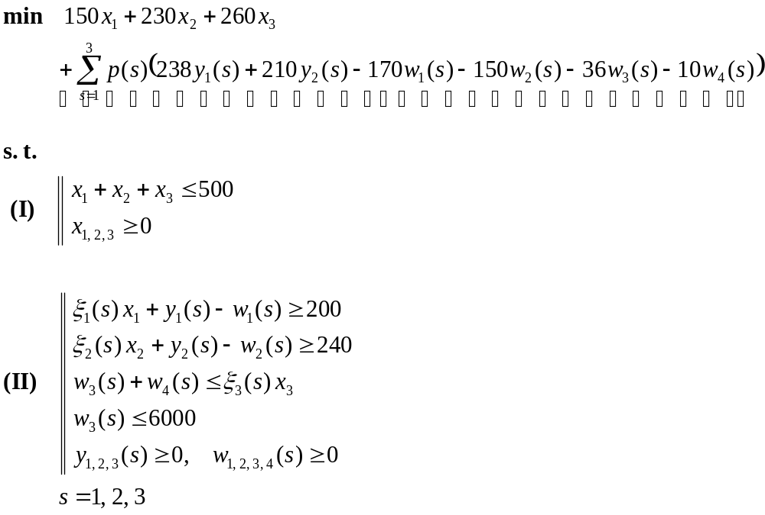
Recourse Reformulation of Stochastic Program (cont’d)
deterministic part (1st stage)
stochastic part (2nd stage)
deterministic constraints
(1st stage)
stochastic constraints
(2nd stage)

Slide 13
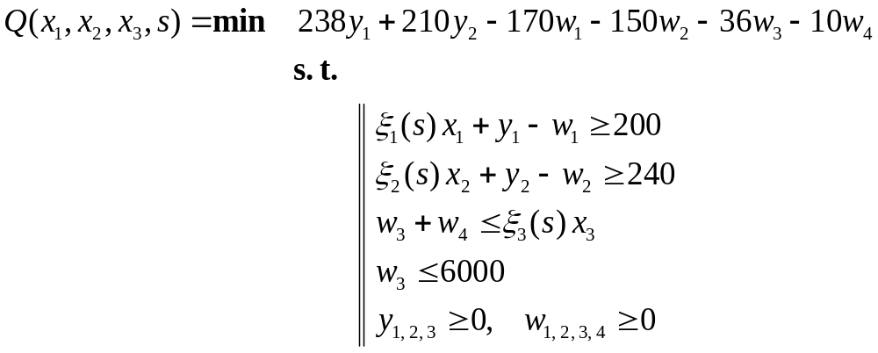

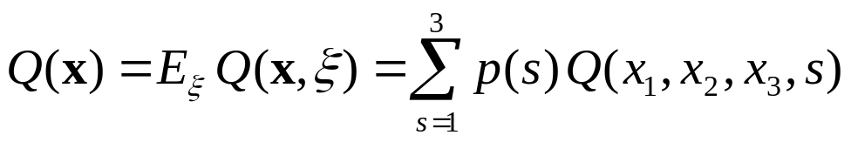
Recourse Reformulation of Stochastic Program (cont’d)
Recourse function:
Expected value of the recourse function:

Slide 14
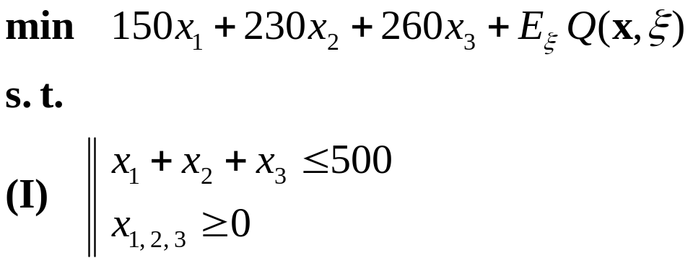
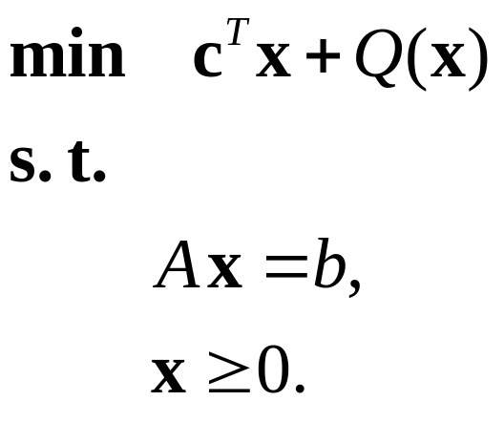
Recourse Reformulation of Stochastic Program (cont’d)
General model formulation:

Slide 15
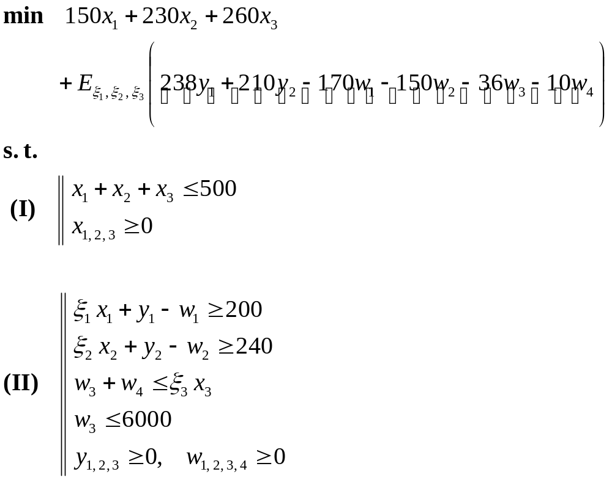
Extensive Formulation of the Stochastic Program
deterministic part (1st stage)
stochastic part (2nd stage)
deterministic constraints
(1st stage)
stochastic constraints
(2nd stage)

Slide 16
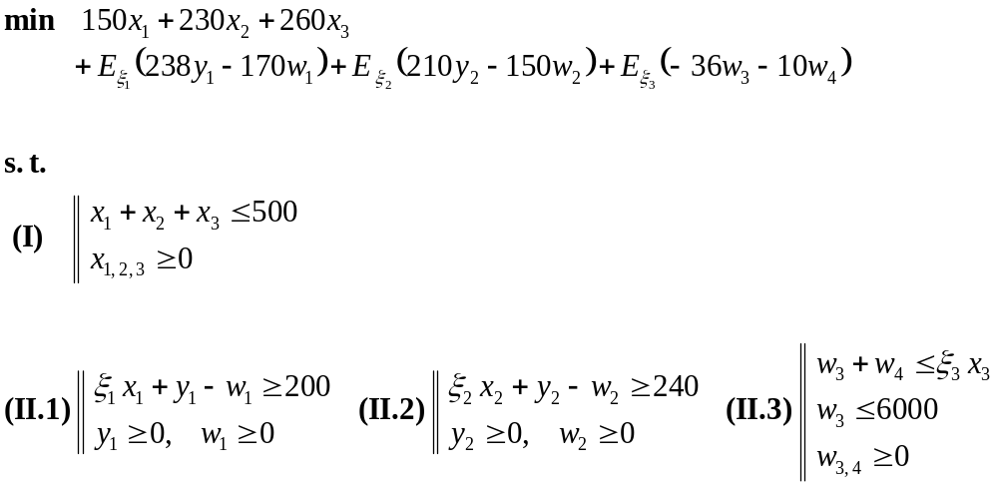
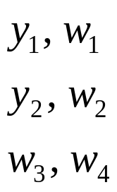






Decomposition of Stochastic Program
sugar beets
corn
wheat
depend only upon decision and random yield (wheat)
depend only upon decision and random yield (corn)
depend only upon decision and random yield (sugar beets)

Slide 17
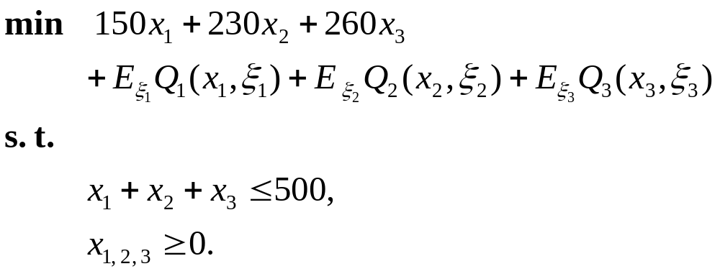
Recourse Formulation of Stochastic Program

Slide 18
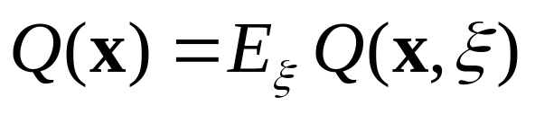
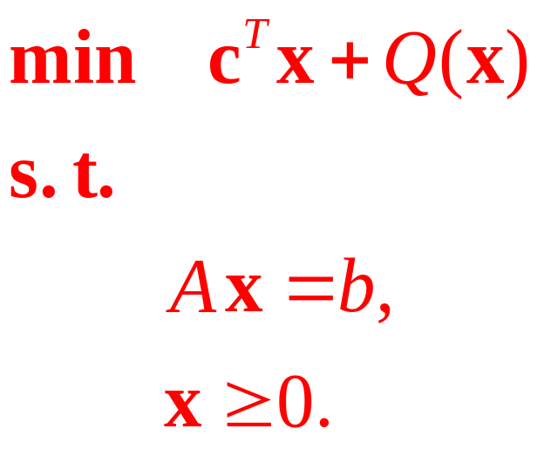
Problem with Recourse
Recourse function:

Slide 19

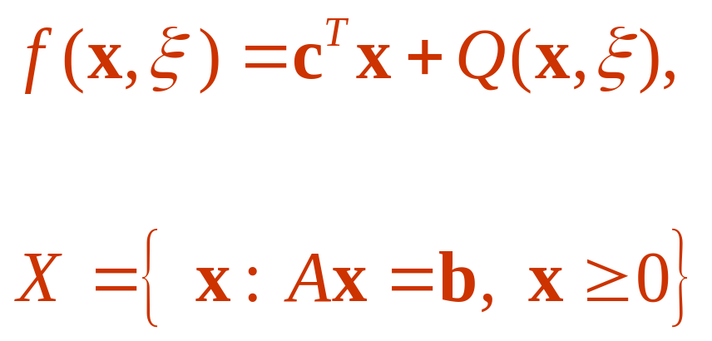
Problem with Recourse (cont’d)
where

Slide 20
Recourse Reformulation of Stochastic Program
- s-th scenario
Random matrix

Slide 21
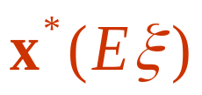


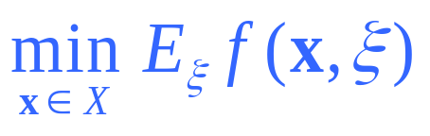
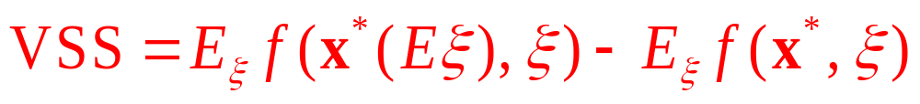
Value of Stochastic Solution (VSS)
Expected value solution
is an optimal solution of
Stochastic programming solution
is an optimal solution of
VSS

Slide 22
Stochastic Programming Solution

Slide 23
Scenario Analysis
Optimal solution based on expected yields
Scenario 2

Slide 24
Scenario Analysis (cont’d)
Optimal solution based on above average yields (+20%)
Scenario 1
Optimal solution based on below average yields (-20%)
Scenario 3

Slide 25
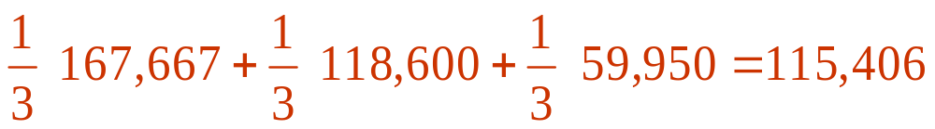
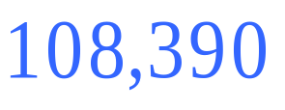
Farming Example, EVPI
Solution with perfect information
Stochastic programming solution

Slide 26

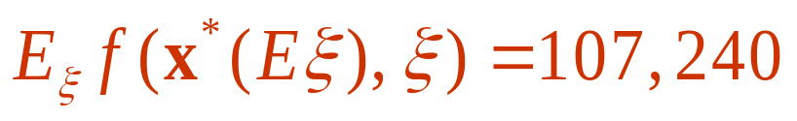
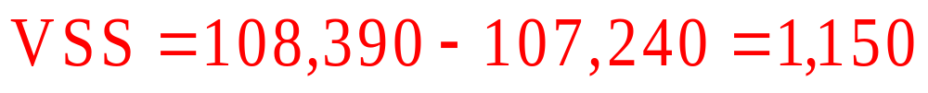
Farming Example, VSS
Expected value solution
is an optimal solution of
Stochastic programming solution
VSS

